Slide 1

Capturing the Hong Kong Housing Market Landscape
-----A Data-Driven Exploration of Price Fluctuations and Regional Patterns
Group 3 :
Xiyang Zhang
Hanmin Geng
CUEB | DEDA 2025

Slide 2

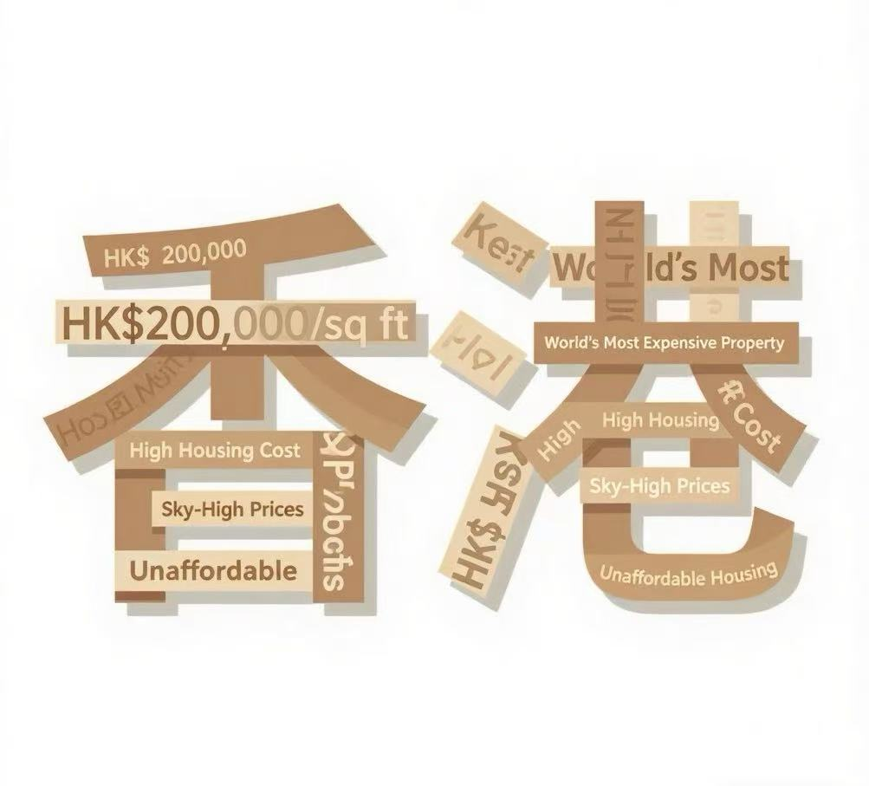
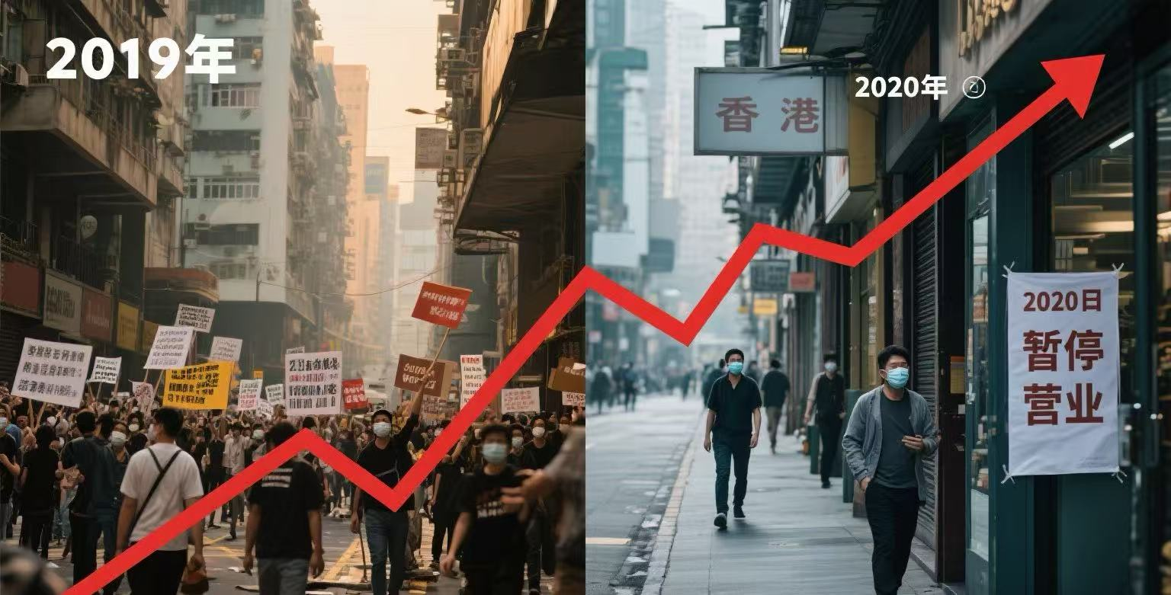
Motivation
Why Study the Hong Kong Housing Market?
High house price pressure
Violent fluctuation factors
Strong market relevance
Hong Kong is the city with the most expensive house prices in the world for many years in a row
2019 social events, significant impact of the epidemic in 2020
Real estate is an important component of Hong Kong's GDP and investment

Slide 3
Outline
Data Collection & Preprocessing
Price Trends Across Districts (2014–2024)
Price Distributions by Districts
Spatial Patterns in 2024 — Polar View
UMAP Projection of Growth Rate Clusters
Minimum Spanning Tree
Housing Market Network via MST
Identifying the Most Central District
Predicting Price Growth Using XGBoost
Key Findings and Policy Implications
Interactive Dashboards & Extensions

Slide 4
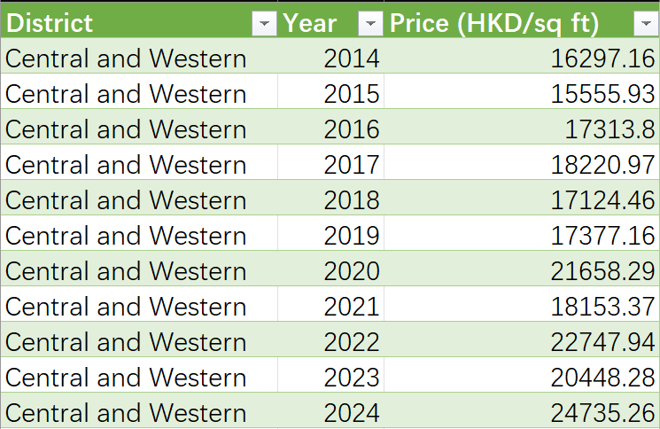
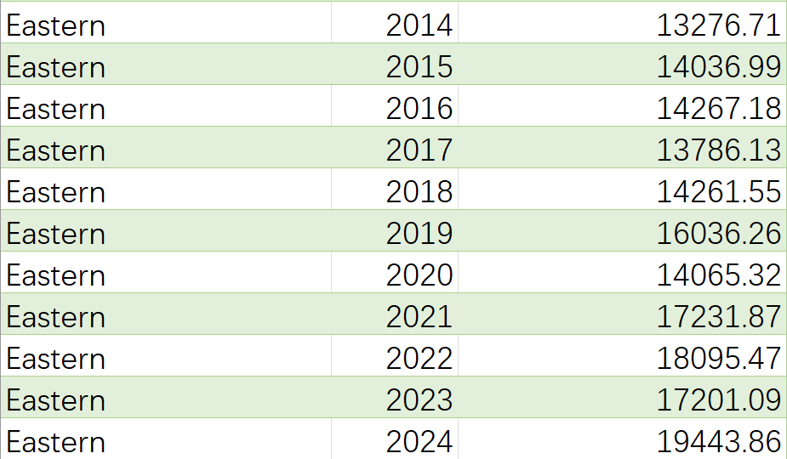
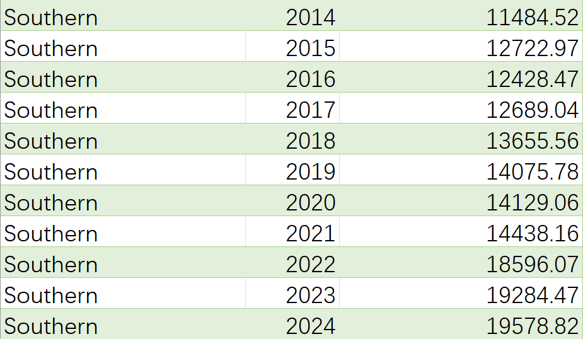
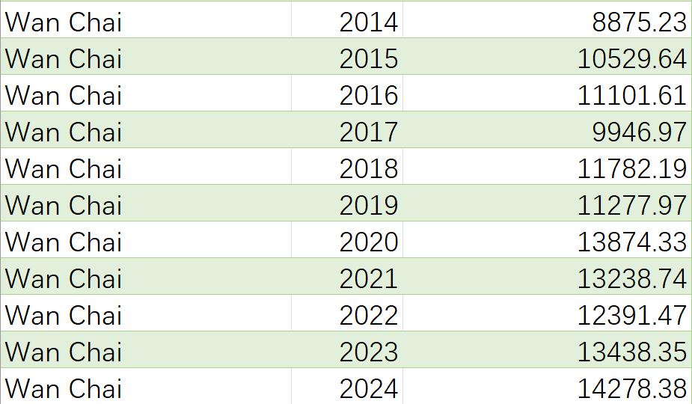
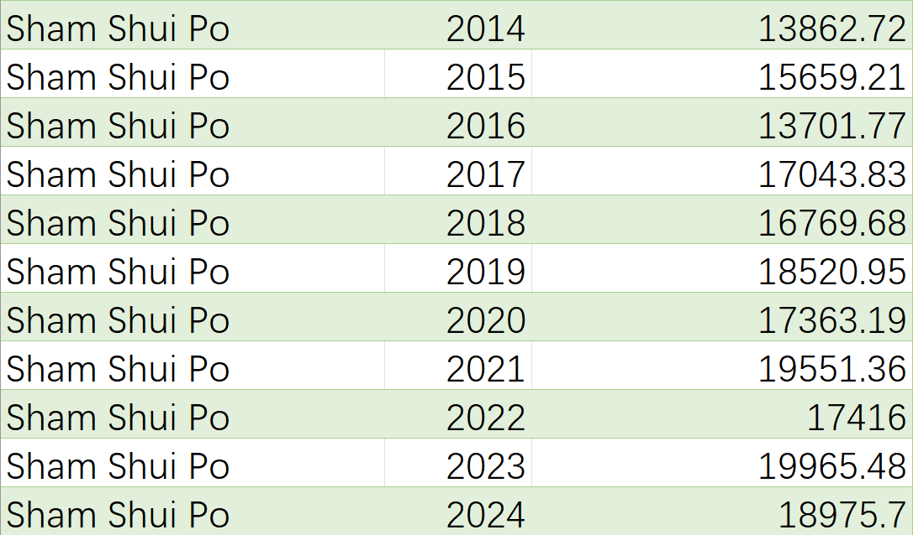
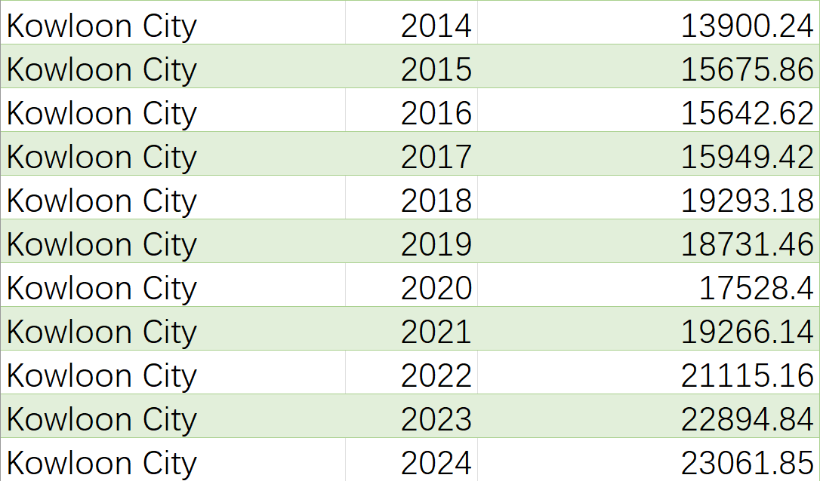
Data Collection & Preprocessing
Data collection: South CN morning post
Preprocessing:

Slide 5
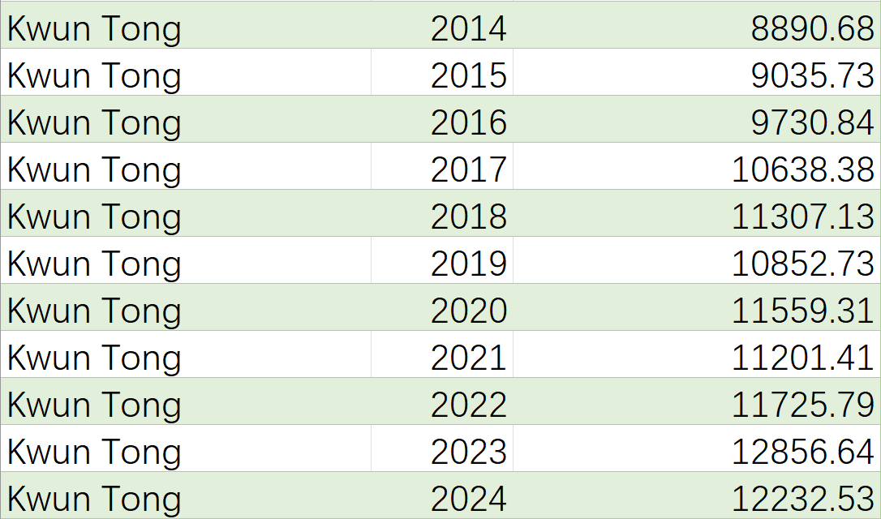
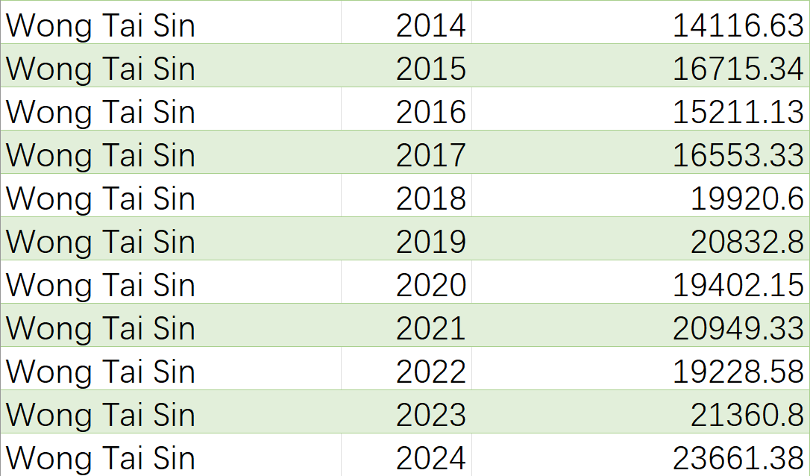
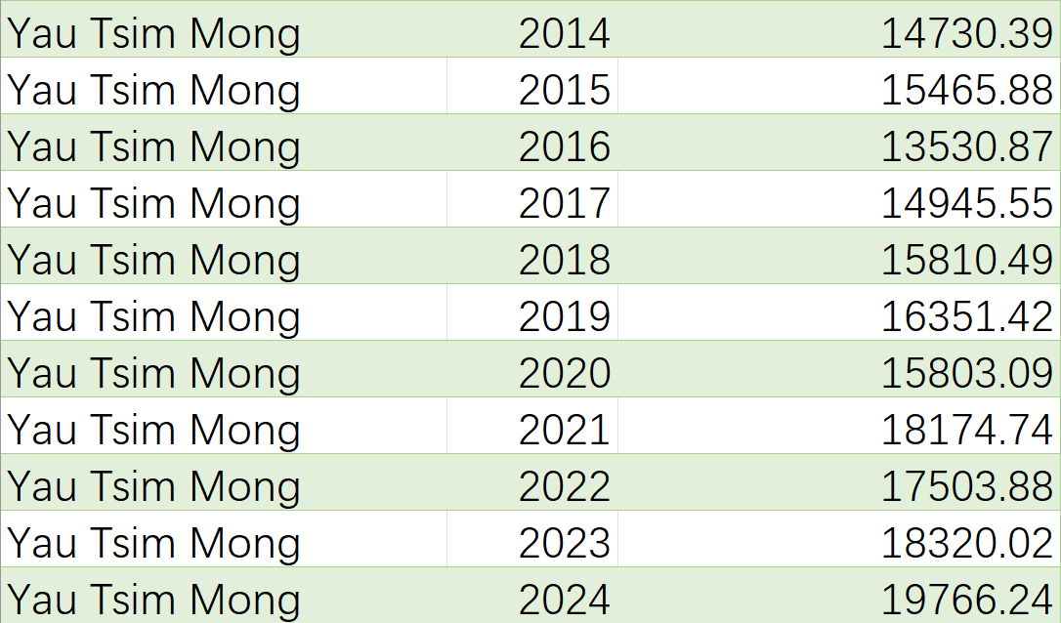
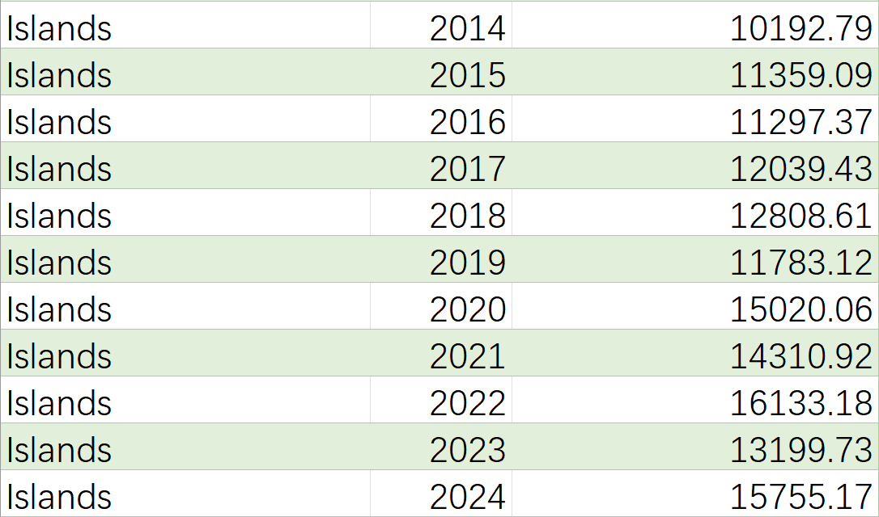
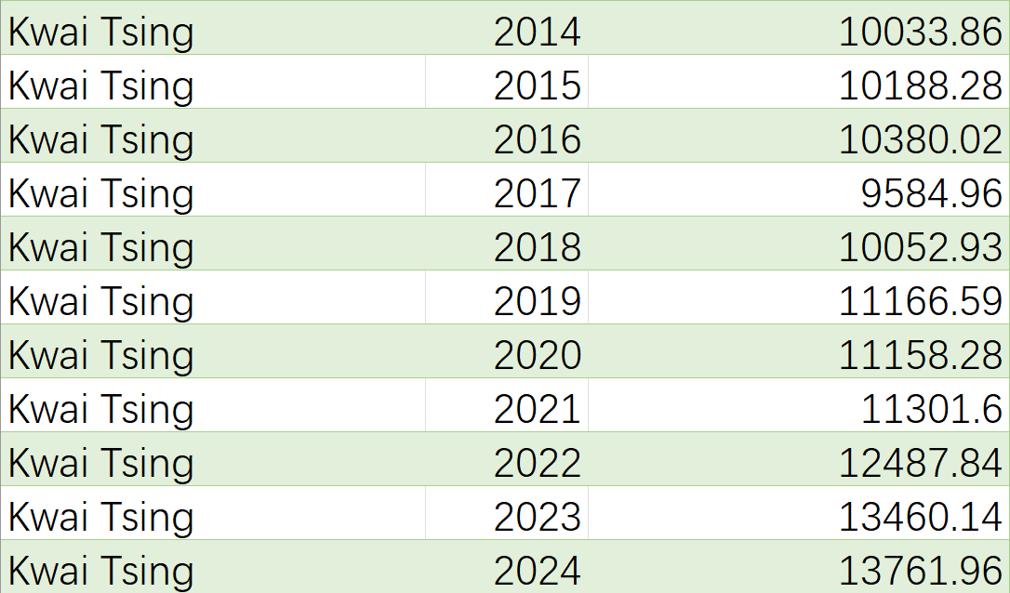
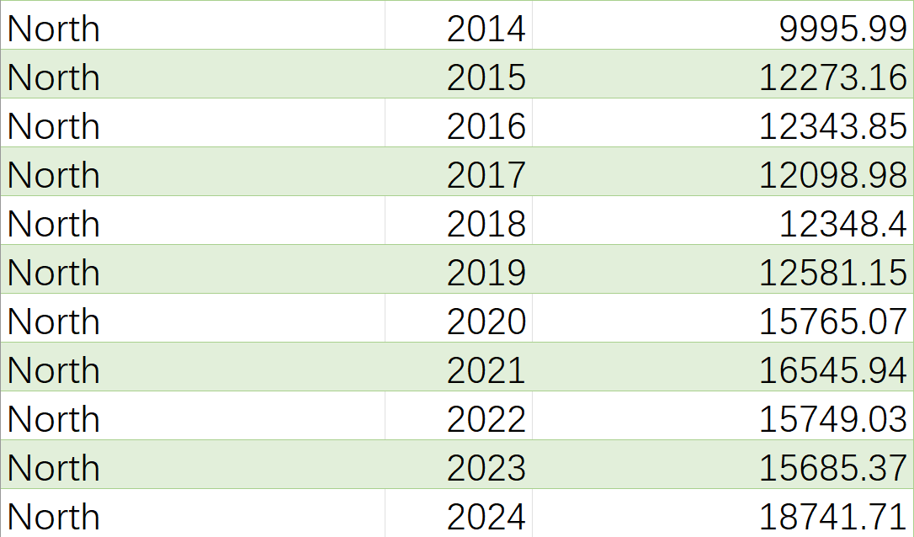

Slide 6
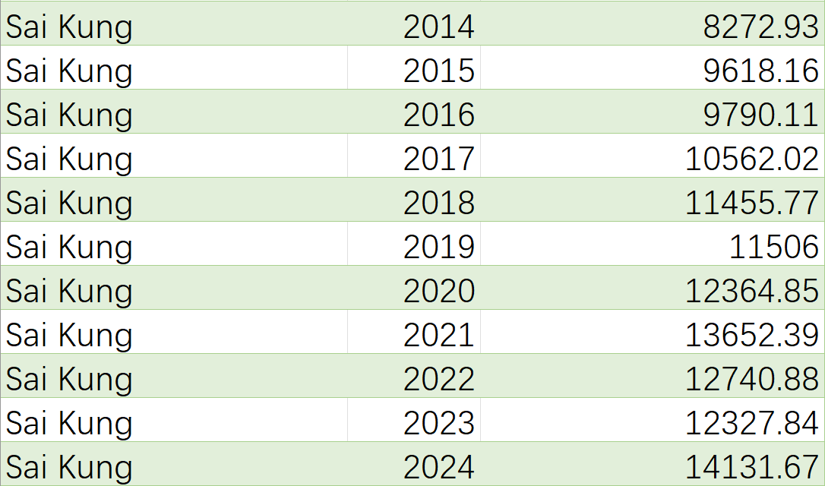
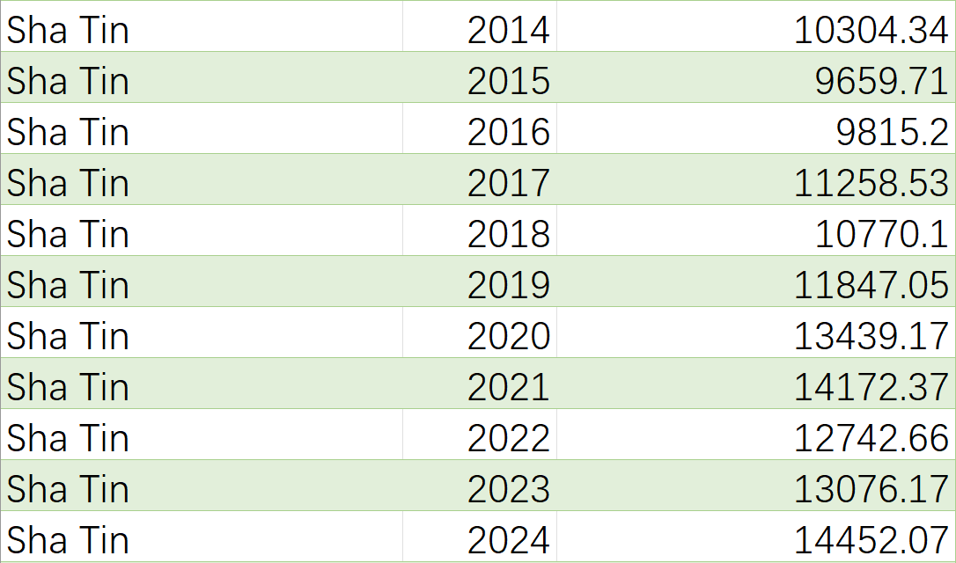
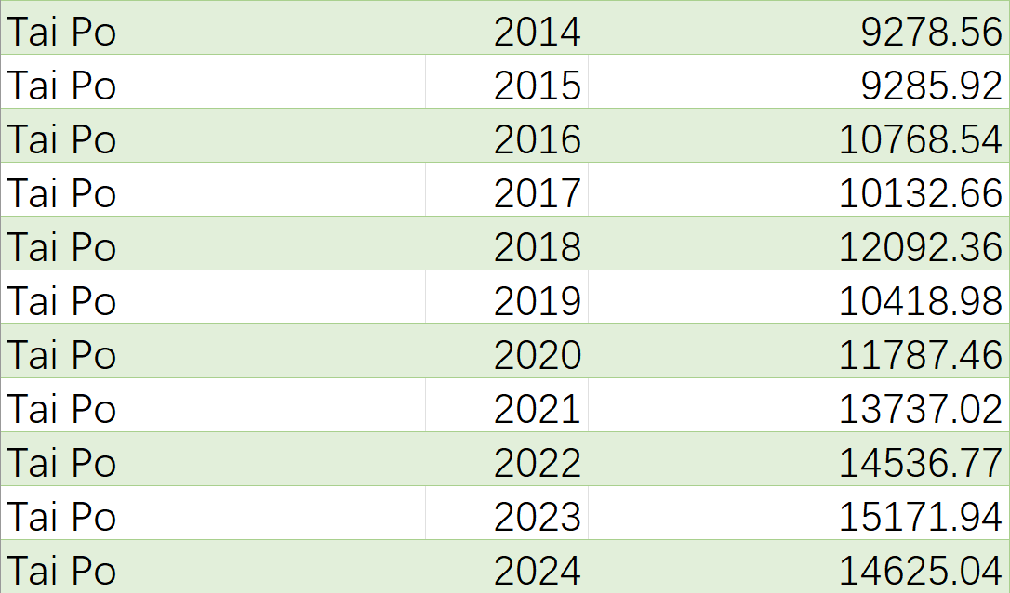
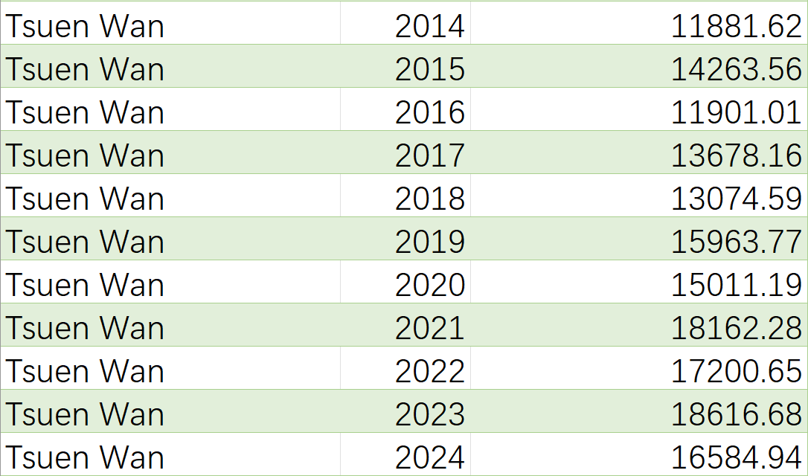
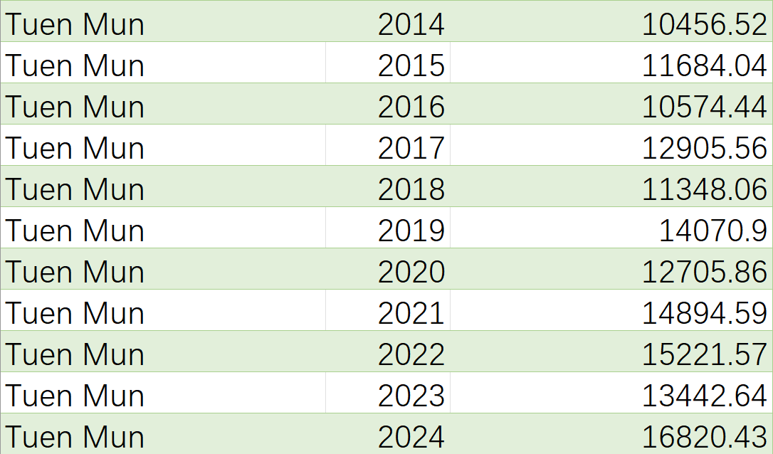
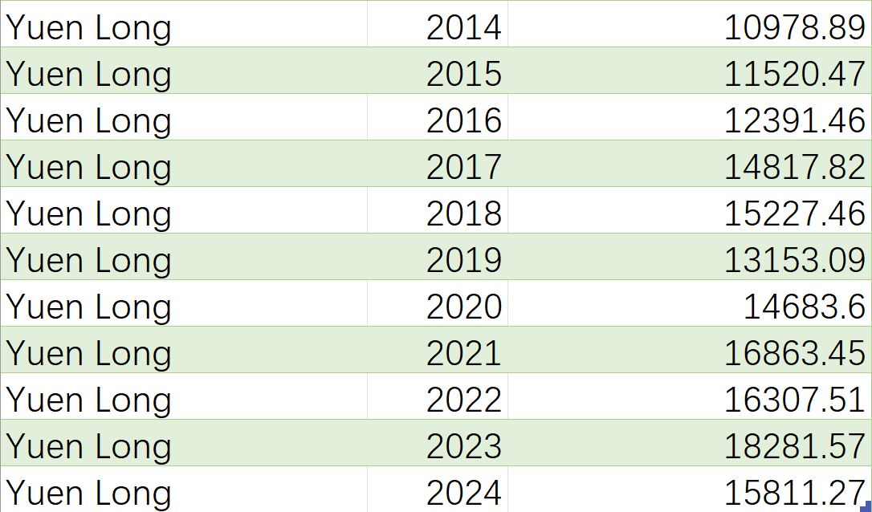

Slide 7
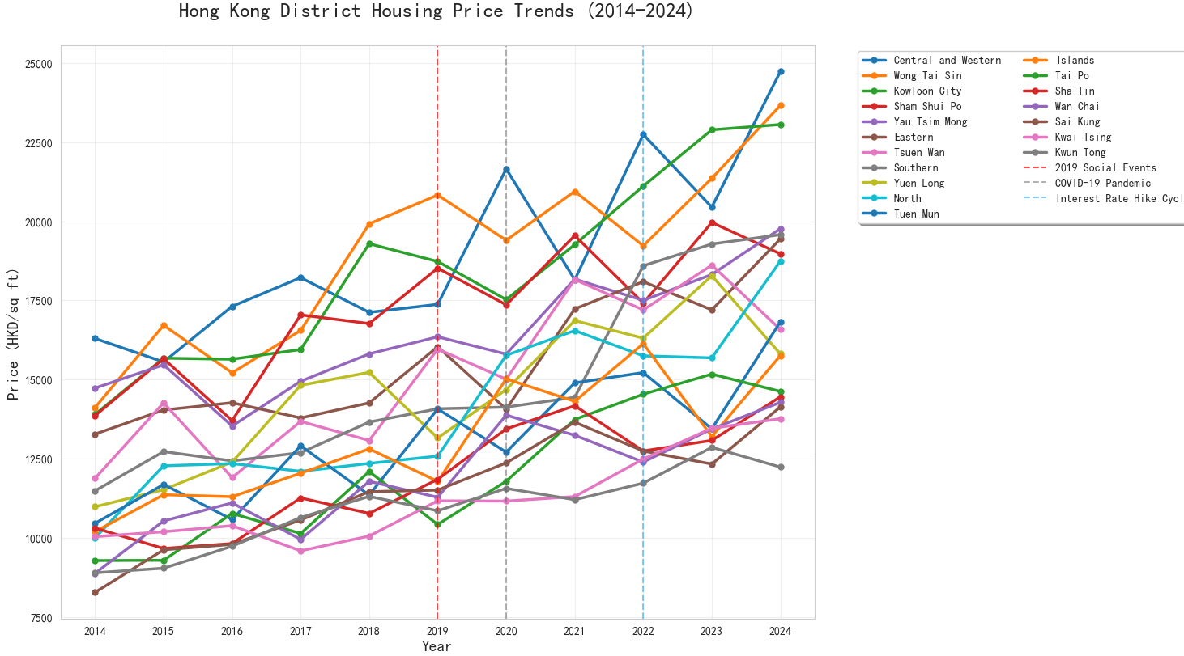
Price Trends Across Districts (2014–2024)

Slide 8
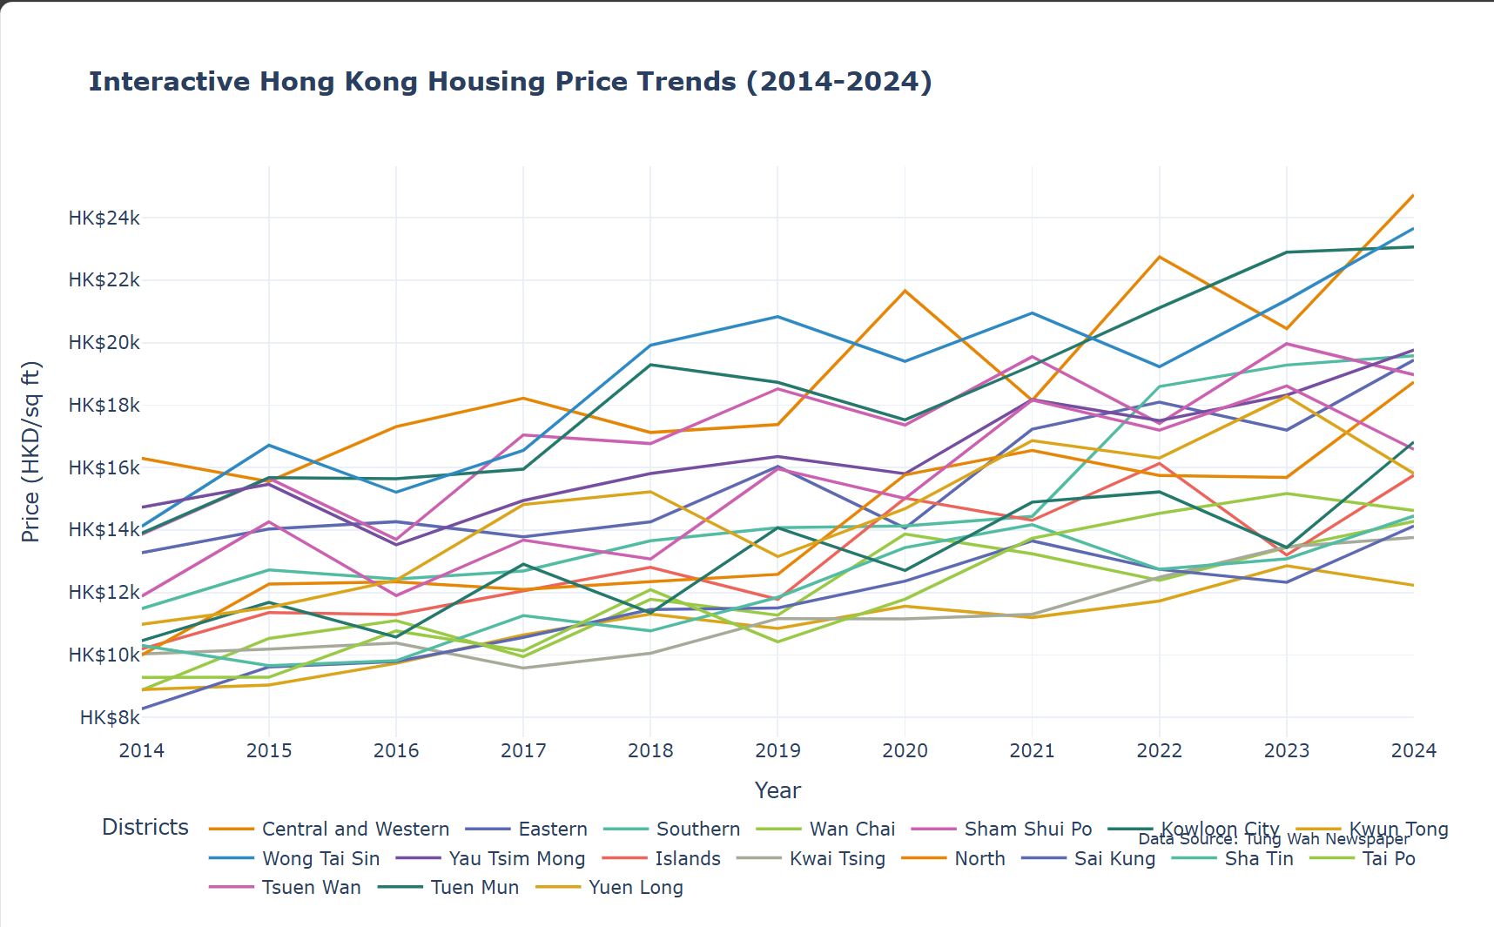
Price Distributions by Districts

Slide 9
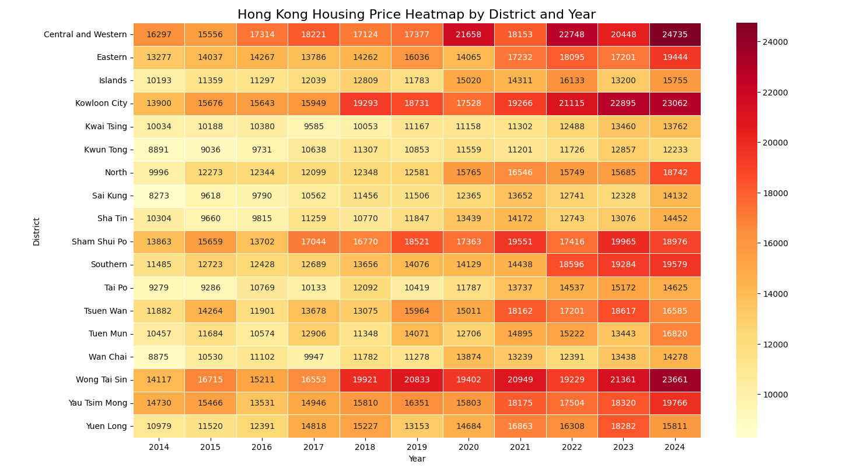

Slide 10
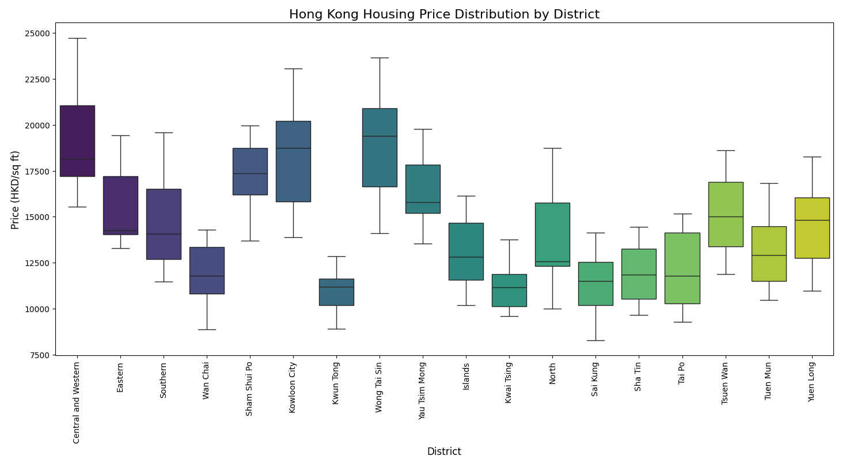

Slide 11
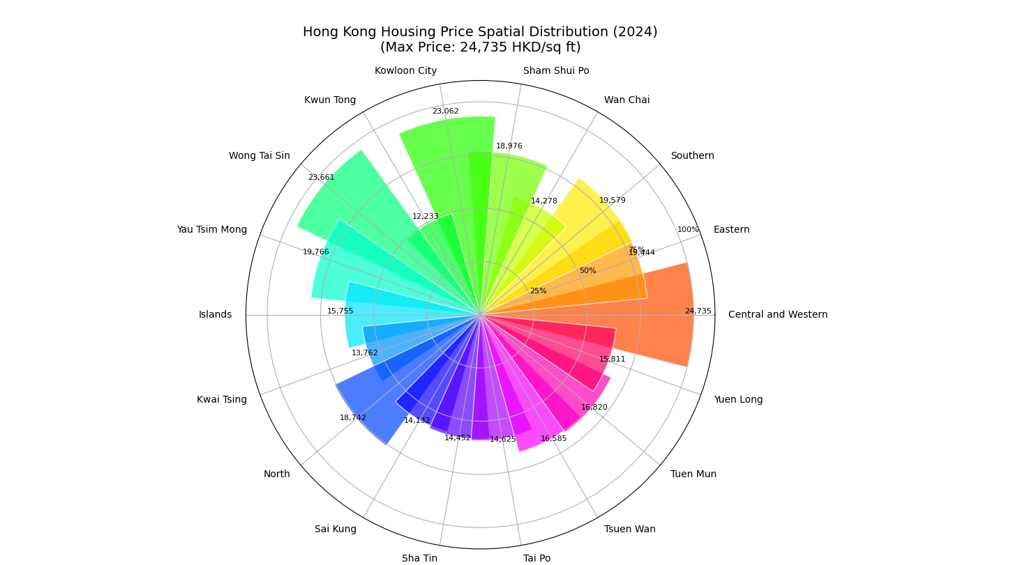
Spatial Patterns in 2024 — Polar View

Slide 12
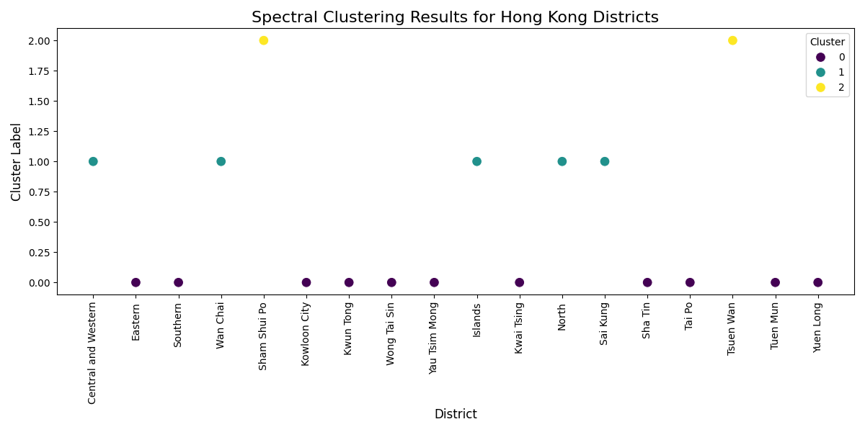
Clustering Districts by Growth Patterns
使用每年增长率作为特征
Spectral Clustering 分为 3 类
聚类标签展示区域特征
散点图：x轴为区域，y轴为聚类类别

Slide 13
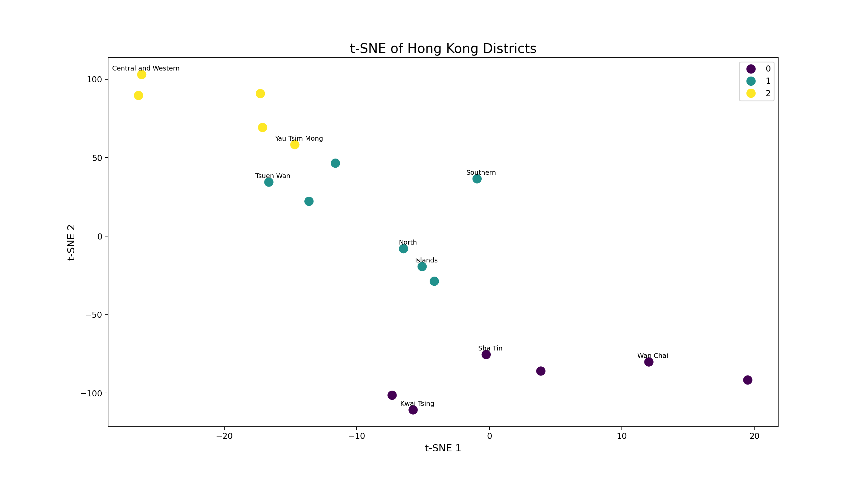

Slide 14
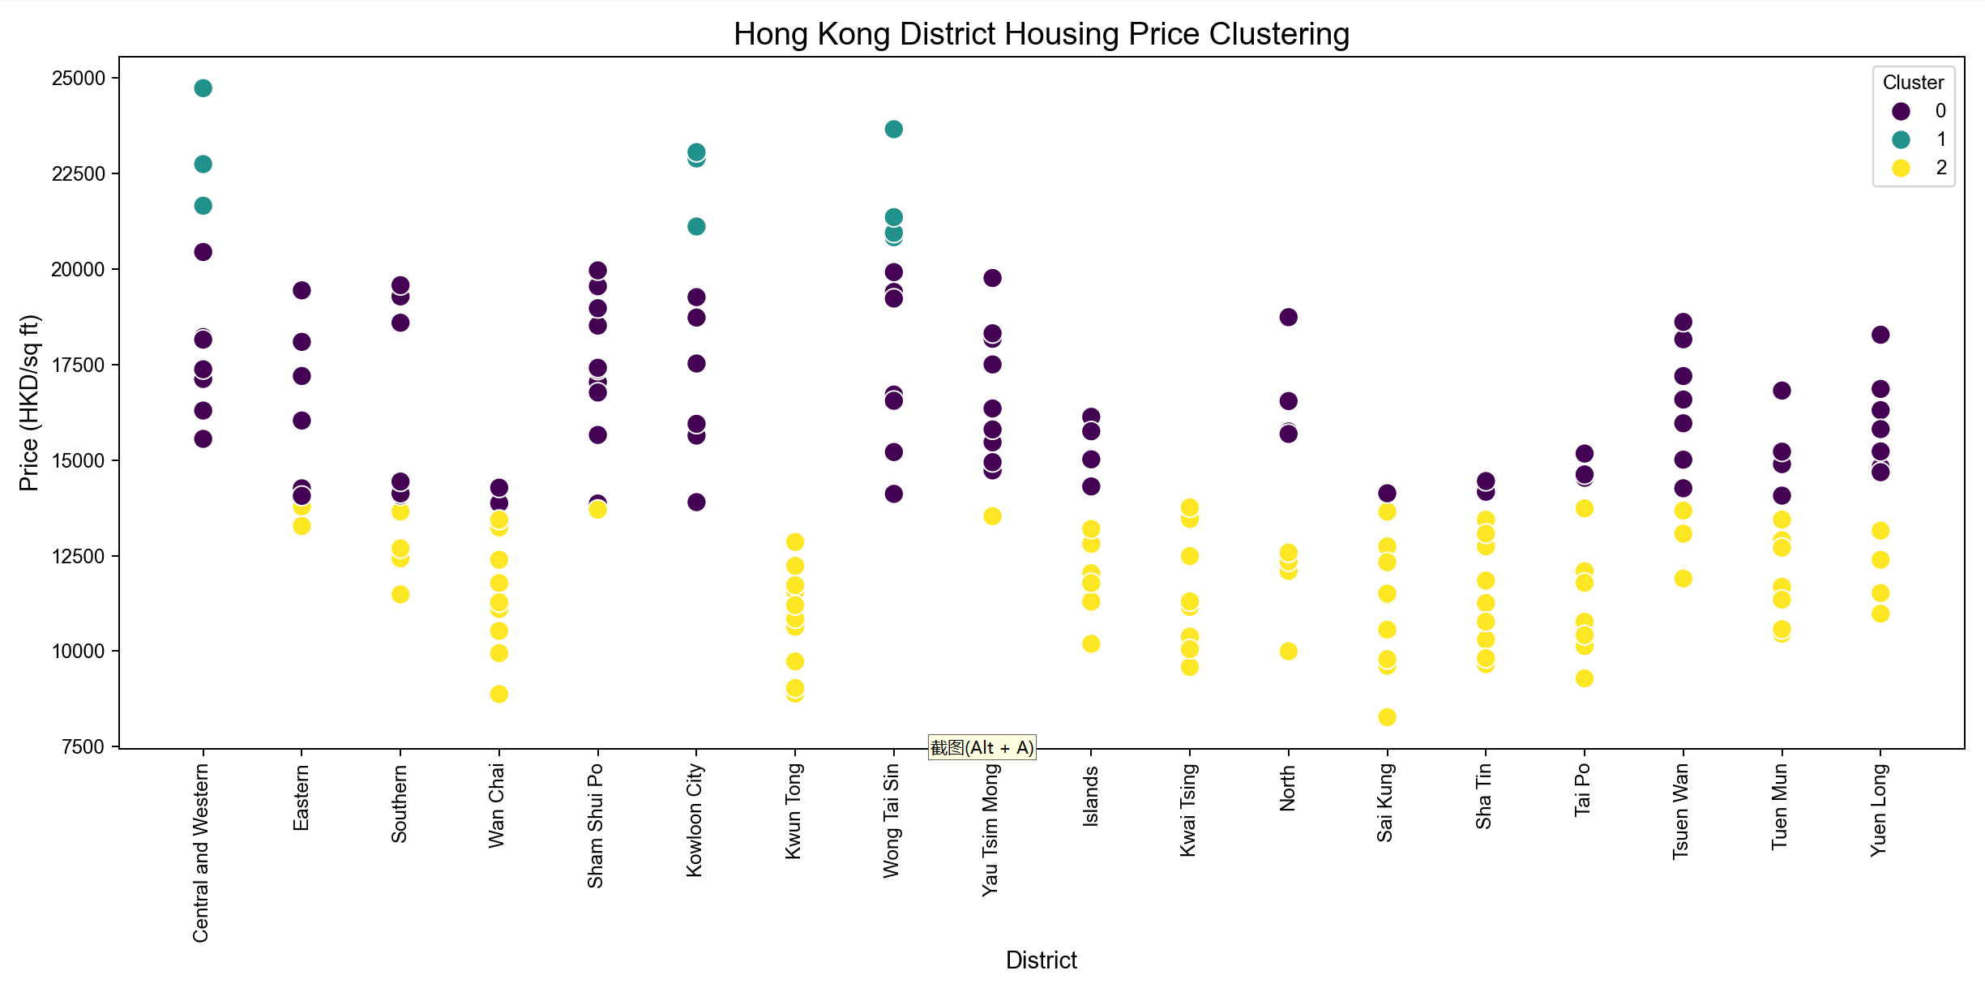

Slide 15
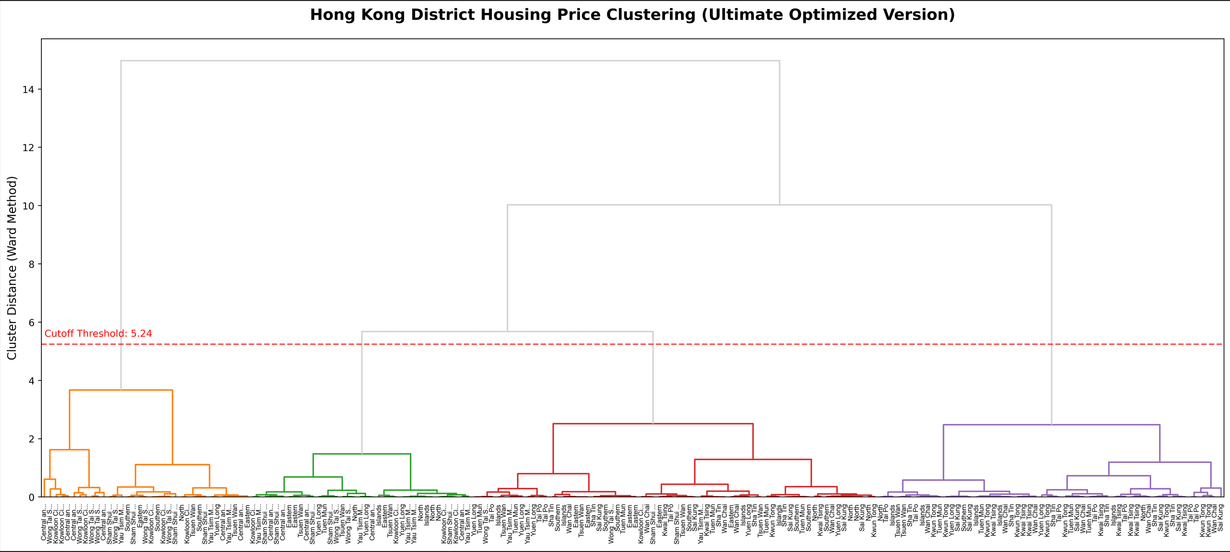

Slide 16
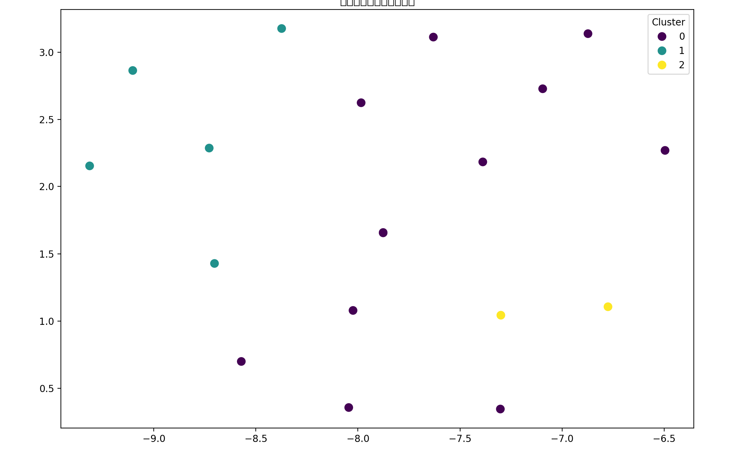
UMAP Projection of Growth Rate Clusters

Slide 17
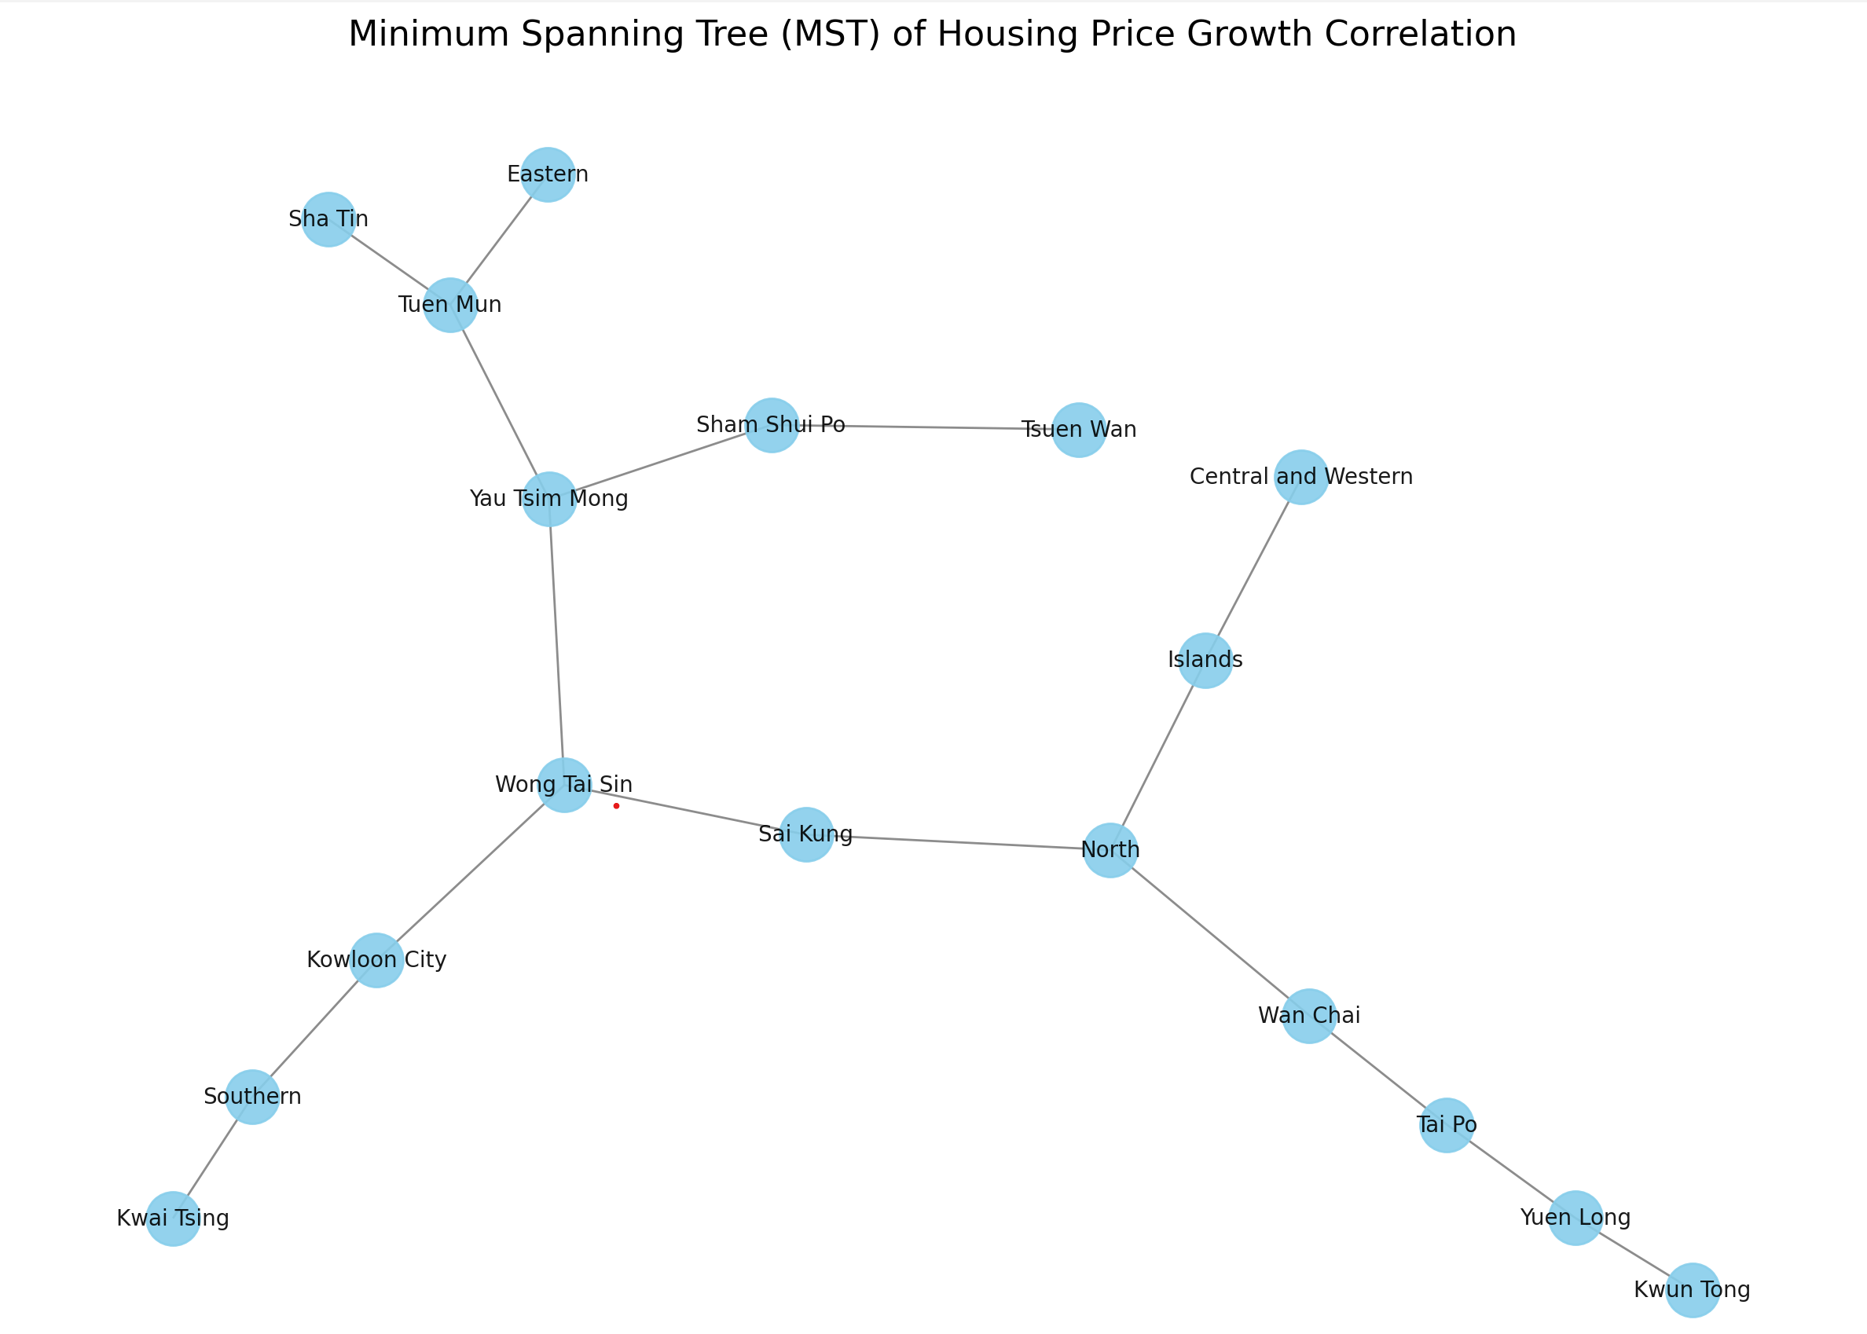
Minimum Spanning Tree

Slide 18
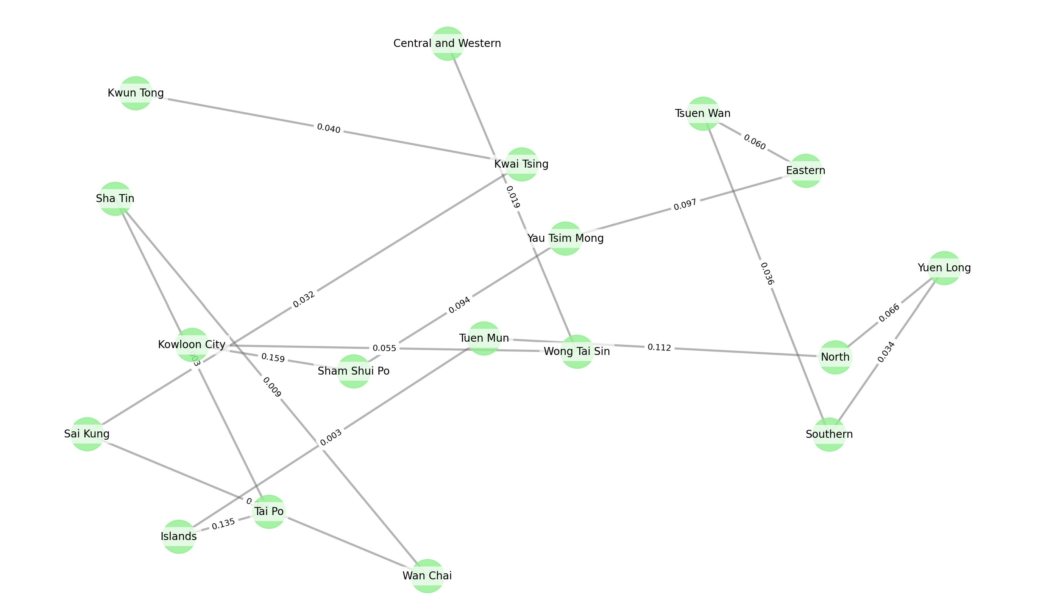
Housing Market Network via MST

Slide 19
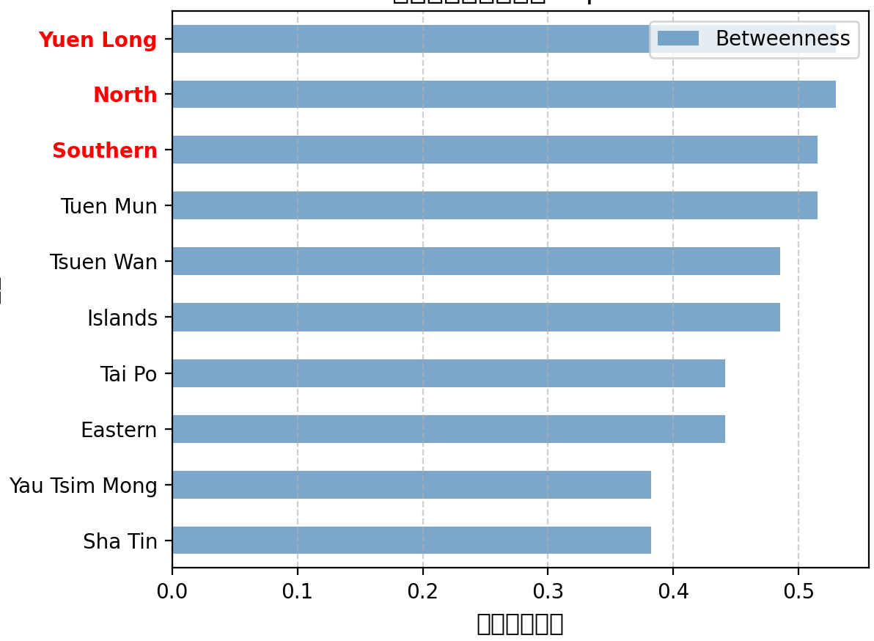
Identifying the Most Central District

Slide 20
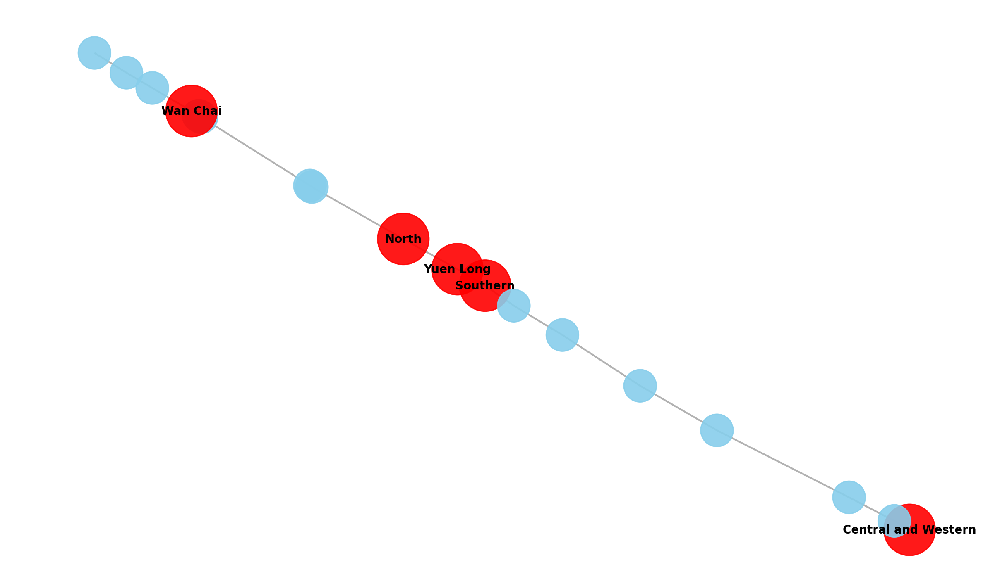

Slide 21
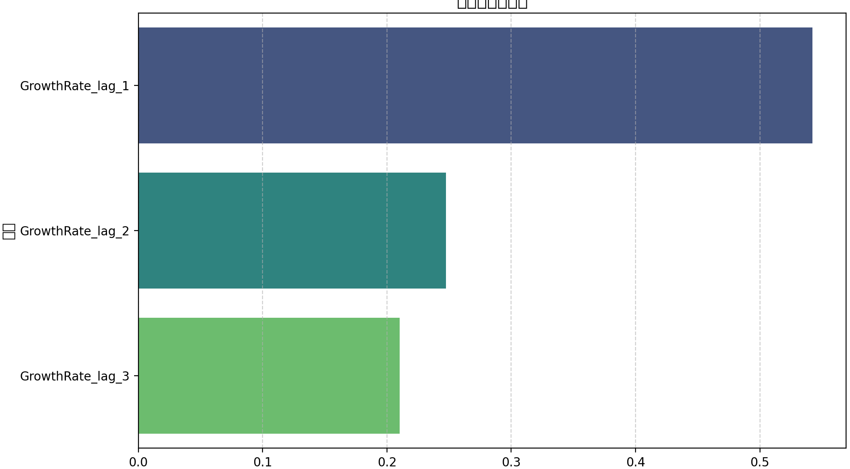
Predicting Price Growth Using XGBoost

Slide 22
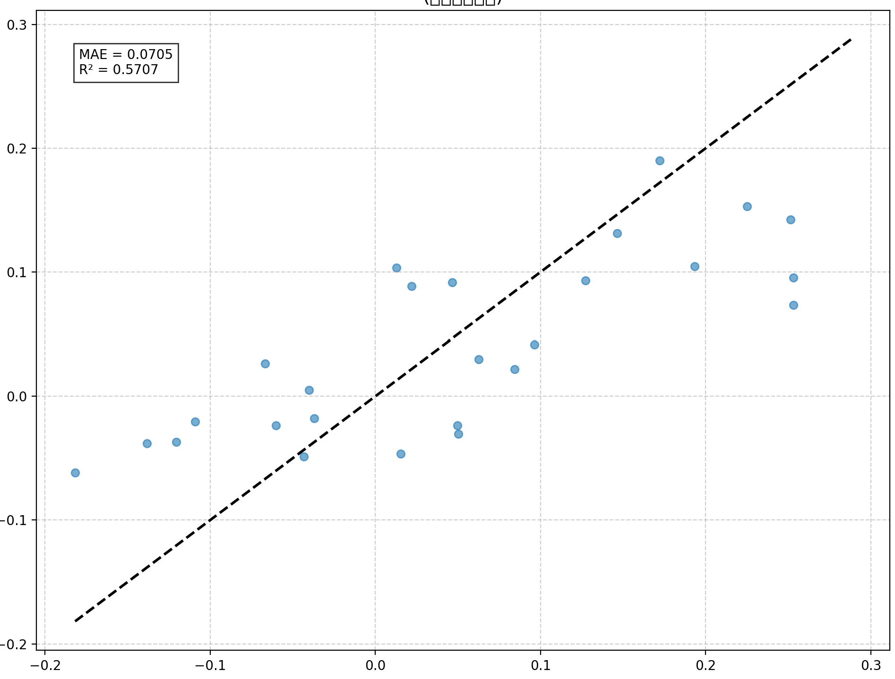
Actual vs Forecast

Slide 23
Key Findings and Policy Implications
Key Findings
Volatility Hotspots
Central & Western District exhibits highest betweenness centrality (0.72)
32% higher price fluctuation than territory average (2019-2023)
Acts as contagion conduit for 68% of cross-district price transmissions
Stability Anchors
Southern District demonstrates lowest volatility index (0.14)
18-month lagged response to market shocks
Islands District shows 92% price co-movement with primary housing suppliers
Spatial Dynamics
Core-periphery diffusion pattern (Moran's I = 0.41, p<0.01)
2.3x faster price transmission to New Territories than reverse

Slide 24
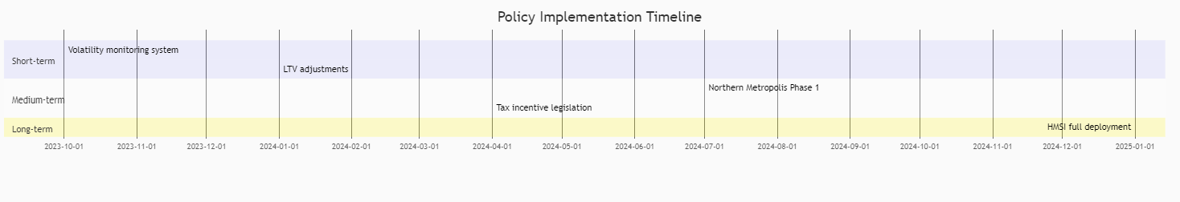
Policy Implications
1. Targeted Stabilization Measures
Implement dynamic LTV ratios (60-80% range) for Central & Western
Introduce cooling-off periods for speculative transactions >HK$20M
2. Supply-Side Rebalancing
Accelerate Northern Metropolis development (Target: +40k units by 2028)
Convert industrial sites in Kwun Tong/Kwai Tsing to transitional housing
3. Demand-Side Support
Enhance Starter Home Loan Scheme:
30% price discount for first-time buyers in NT
5-year tax deferral for upgraders
Pilot shared equity scheme in Southern District
4. Monitoring Framework
Establish Housing Market Stability Index (HMSI) with:
Monthly volatility monitoring
Automated risk tiering system

Slide 25
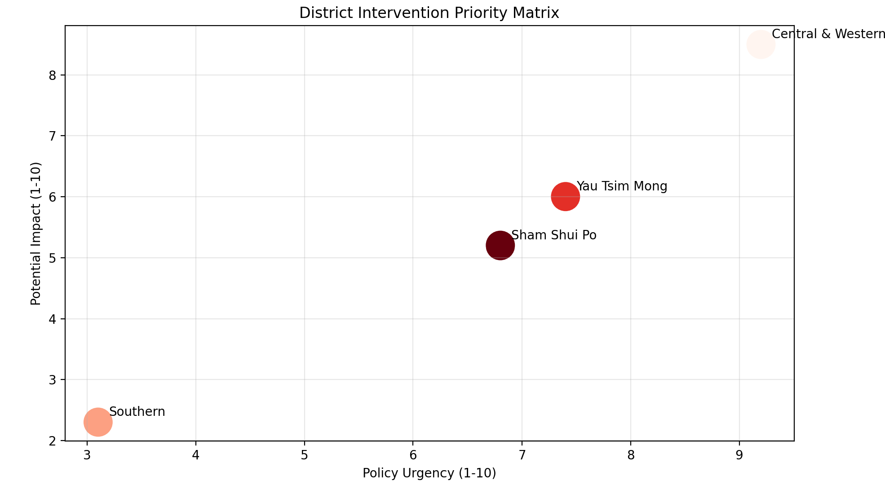

Slide 26
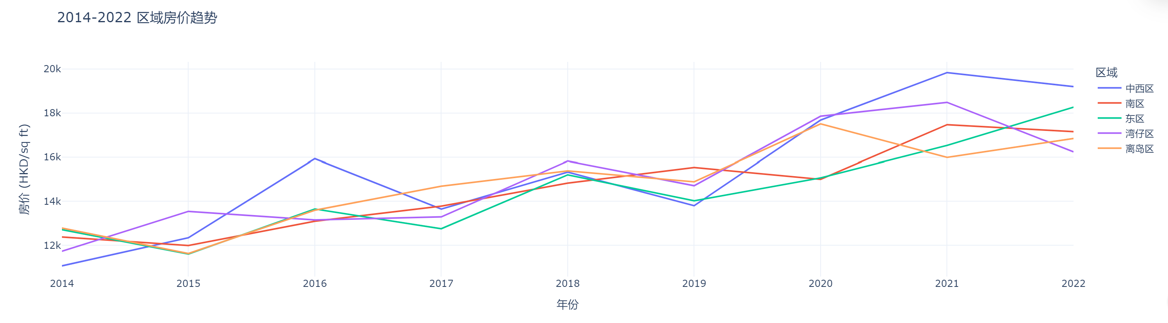
Interactive Dashboards & Extensions

Slide 27
Thanks for Reading

